Slide 1
Smoke Detection System
CS225_CS226 Mini Project
Kavya Goyal 1901CS30

Slide 2
Why this project?
A smoke detection circuit eventually detects smoke and triggers alarms so as to warn the people about the fire. With advancements of IoT devices, this trigger is met by automated response systems like working of mechanical machines or frameworks to suppress the fire.
I have created a small prototype of the same where in detection of smoke, the micro controller unit of the circuit triggers a response to turn a fan on and send a notification to our mobile devices.

Slide 3
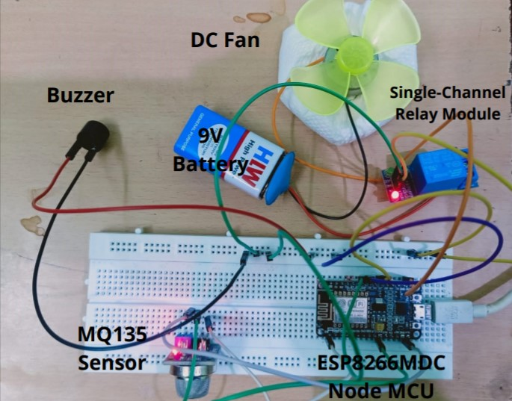
Circuit

Slide 4
Components Used
Node MCU (ESP8266MCD).
MQ135 Smoke Detection Sensor
Single Channel Relay Module
Buzzer
9 Volt Battery with a DC Fan

Slide 5
NodeMCU (ESP8266MCD)
This is the microcontroller unit of the circuit. It takes the power from the usb cable. It has a built in Wi-Fi Module to communicate with mobile devices
2. MQ135 Sensor
This is the smoke detection sensor. It has 4 pins, A0 (Analog), D0 (Digital), GND (Ground), and Vcc pin. The following connections are established.
A0 -> Analog Output of NodeMCU (A0)
GND-> GND of NodeMCU
Vcc -> Vin of NodeMCU

Slide 6
3. Single Channel Relay Module
This works as a open/close switch to turn off/on the DC fan when the smoke/gas level is greater than a threshold value. When the threshold of the smoke level is greater than a desired value, the pin d7 turns on to 1. This model has 3 input pins that are connected to NodeMCU.
IN -> d7
G->GND
3V->3V3 (Power)
Apart from these, +ve terminal of battery to the Common (C) of Relay, -ve terminal of battery to the fan's black wire and Normally Open (NO) of the relay is connected to the fan's red wire.
‘

Slide 7
4. Buzzer
This buzzer turns on a frequency of 300Hz for a duration of 500 ms whenever the gas levels detected are more than the threshold detected (190 units). The connections are given by
D5 of NodeMCU -> Positive (Red wire of Buzzer)
GND of NodeMCU -> Negative(Black wire of Buzzer)
5. 9V Battery with DC Fan
The DC fan is powered by the 9V battery.
+ve terminal of battery to the Common (C) of Relay Module
-ve terminal of battery to the fan's black wire
Normally Open (NO) of the relay module to the fan's red wire.
‘

Slide 8
Pre SetUp
In order to caliber the MQ 135 Sensor, put it in a smoke free environment for a few hours before use when bought,
In order to create a smoke free environment, make the room air conditioned for about 10 minutes. Then, calculate the levels of smoke in the atmosphere with MQ 135 Sensor
In order to create a smoke like environment, I have made use a incense stick used at homes.

Slide 9
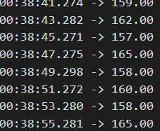
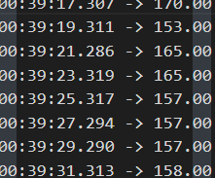
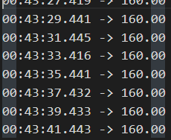
Data Analysis
After careful analysis of the data in absence of smoke
The average of these readings was found to be 162.45

Slide 10
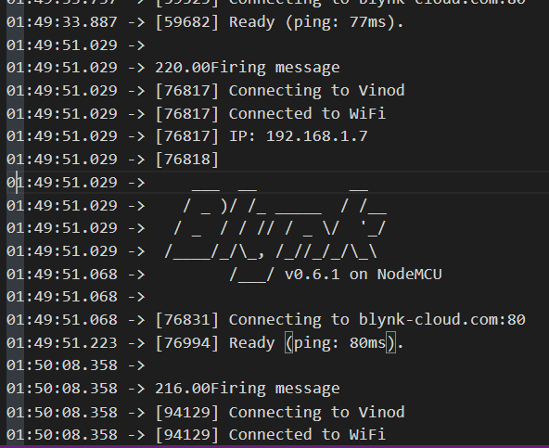
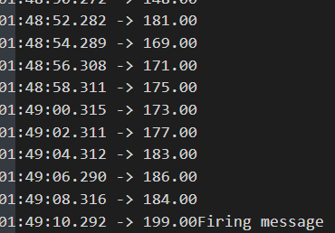
After careful analysis of the data in presence of smoke
with 190 as a threshold.

Slide 11
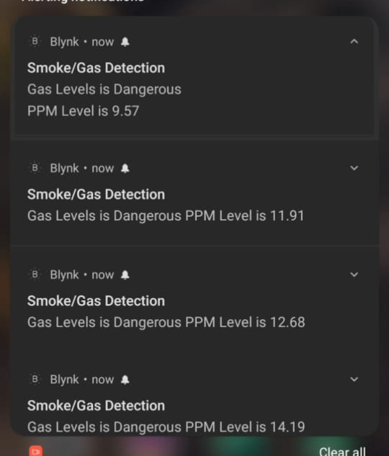
When the levels are greater than 190
The Fan turns on
The buzzer turns on
The Blynk App is connected to our mobiles, and then
sends a notification for the same.

Slide 12
Conclusion
After careful analysis of the data in presence and absence of smoke, I found that after 190 units of smoke, it crosses a “Normal” mark and enters the “Critical” Range. After 250 units, it enters “Dangerous” levels.
This prototype can be used to detect smoke in our houses, and also send notifications for the same.
All the images used in the experimental report and this presentation are in the Media folder
The code is written in C++ in Arduino IDE
The video demonstration is given
The experimental data is given in the ‘Experimental Data” folder

